Slide 1
Client Side Scripting
Events

Slide 2
Events
When you browse the web, your browser registers different types of events
It's the browser's way of saying, "Hey, this just happened."
Your script can then respond to these events
Scripts often respond to these events by updating the content of the web page (via the Document Object Model) which makes the page feel more interactive

Slide 3
Events
Important Event aspects:
Interactions create events
Events occur when users click on a link, hover or swipe over an element, type on the keyboard, resize a window, or when the page they requested loads
Events trigger code
When the even occurs or fires, it can be used to trigger a particular function
Different code can be triggered when users interact with different parts of the page
Code responds to users
The events can trigger the kinds of changes the DOM is capable of
This is how a page reacts to users

Slide 4
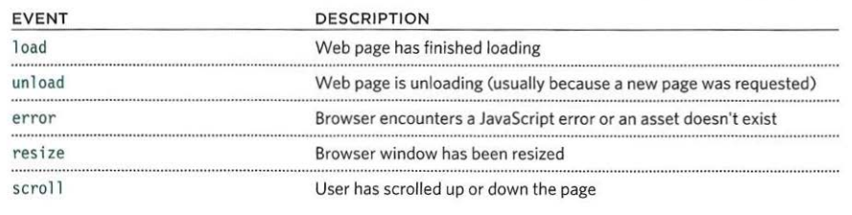
Different Event Types UI Events
UI Events occur when a user interacts with the browser's user interface (UI) rather than the web page

Slide 5
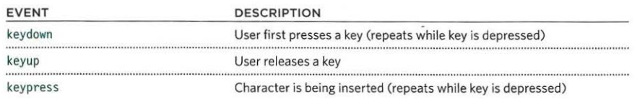
Different Event Types Keyboard Events
Keyboard Events occur when a user interacts with the keyboard (see also input event)

Slide 6
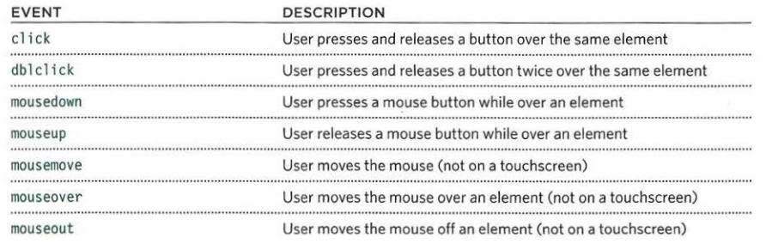
Different Event Types Mouse Events
Mouse Events occur when a user interacts with a mouse, trackpad, or touchscreen

Slide 7
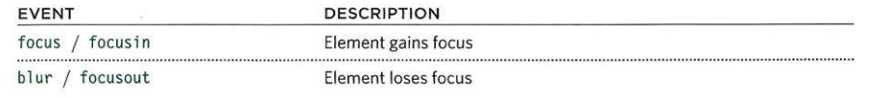
Different Event Types Focus Events
Focus Events occur when an element (e.g., a link or form field) gains or loses focus

Slide 8
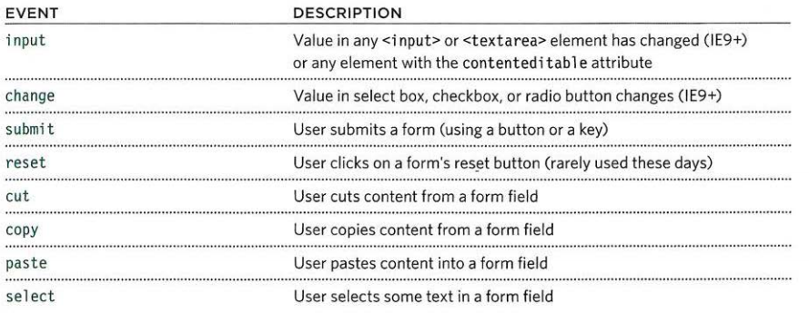
Different Event Types Form Events
Form Events occur when a user interacts with a form element

Slide 9
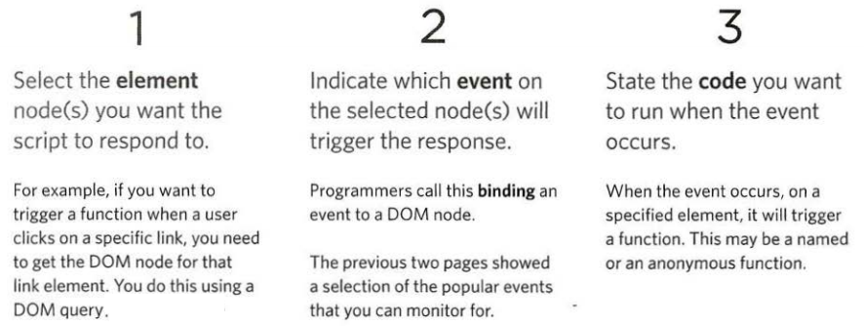
How Events Trigger Code
When the user interacts with the HTML on a web page, there are three steps involved in getting it to trigger some JavaScript code. Together these steps are known as event handling

Slide 10
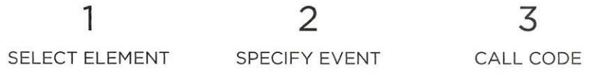
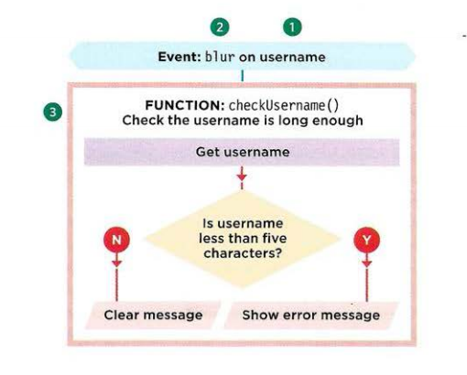
How Events Trigger Code
Here you can see how event handling can be used to provide feedback to users filling in a registration form
It will show an error message if their username is too short

Slide 11
How Events Trigger Code
Select Element:
The element that users are interacting e.g. Text field for username
Specify Event:
When users move out of the text input, it loses focus, and the blur event fires on this element
Call Code:
When the blur event fires on the username input, it will trigger a function called checkUsername()
This function checks if the username is less than 5 characters
If there are not enough characters, it shows an error message that prompts the user to enter a longer username
If there are enough characters, the element that holds the error message should be cleared
This is because an error message may have been shown to the user already and they subsequently corrected their mistake.
(If the error message was still visible when they had filled in the form correctly, it would be confusing.)

Slide 12
Event Handlers HTML Event Handlers
Early versions of HTML included a set of attributes that could respond to events on the element they were added to
The attribute names matched the event names
Their values call the function that was to run when that event occurred
For example, the following:
<a onclick=“hide()”>
indicated that when a user clicked on this element, the hide () function would be called
This method of event handling is not an ideal one since it is better to separate JavaScript from HTML

Slide 13
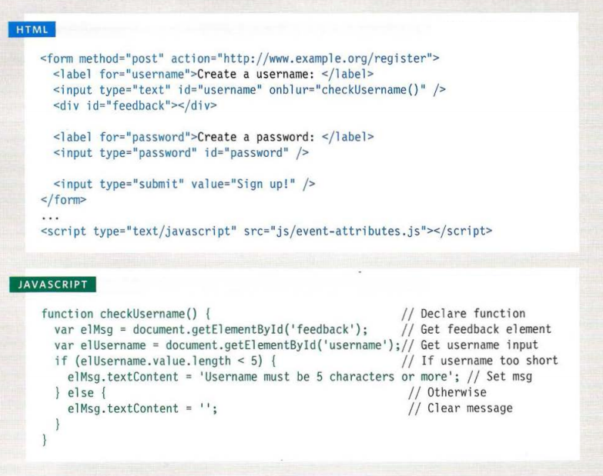

Slide 14

Practice
Access Moodle and work out Worksheet 11

Slide 15
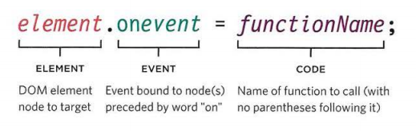
Event Handlers DOM Event Handlers
All modern browsers understand this way of creating an event handler, but you can only attach one function to each event handler
Here is the syntax to bind an event to an element using an event handler, and to indicate which function should execute when that event fires:

Slide 16
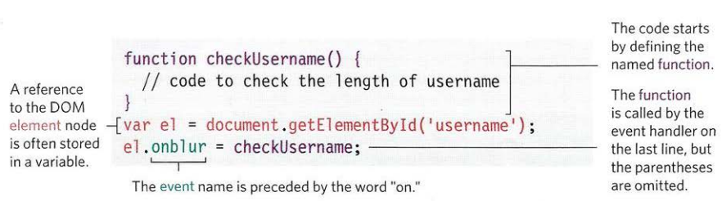
Event Handlers DOM Event Handlers
Below, the event handler is on the last line (after the function has been defined and the DOM element node(s) selected)
With a function call, the brackets tell the JavaScript interpreter to "run this code now."
We want the code to run when the event fires, so we have to omitt the parentheses

Slide 17
Event Handlers DOM Event Handlers
Below, the event handler is on the last line (after the function has been defined and the DOM element node(s) selected)
With a function call, the brackets tell the JavaScript interpreter to "run this code now."
We want the code to run when the event fires, so we have to omitt the parentheses

Slide 18
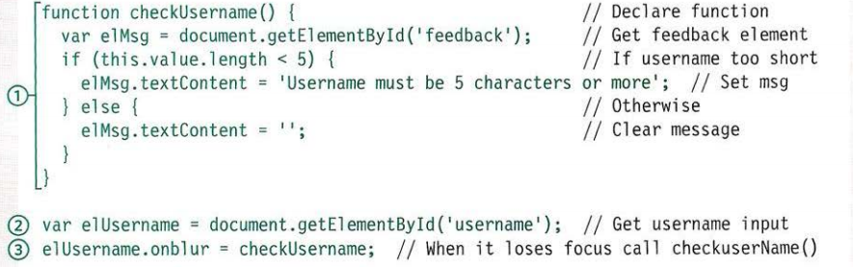
Event Handlers DOM Event Handlers

Slide 19
Event Handlers DOM Event Handlers
In the previous example, the event handler appears on the last line of the JavaScript. Before the DOM event handler, two things are put in place:
The function to be fired should be defined first.
The DOM element node is stored in a variable. E.g. The text field is stored in a variable called elUsername. The event name is preceded by the word "on” e.g. onsubmit.
On the last line, the event handler elUsername.onblur indicates that the code is waiting for the blur event to fire on the element stored in the variable called elUsername. This is assigned to the function that will run when the event fires on that element.

Slide 20
Event Handlers DOM Event Handlers
The HTML code will be the same but without the (e.g.) onblur event attribute.
This means that. the event handler is in the JavaScript, not the HTML.
Browser support:
On line 3, the checkUsername() function uses the this keyword in the conditional statement to check the number of characters the user entered. It works in most browsers because they know this refers to the element the event happened on.
However, in Internet Explorer 8 or earlier, IE would treat this as the window object. As a result, it would not know which element the event occurred on and there would be no value that it checked the length of, so it would raise an error.

Slide 21
Practice
Access Moodle and work out Worksheet 12

Slide 22
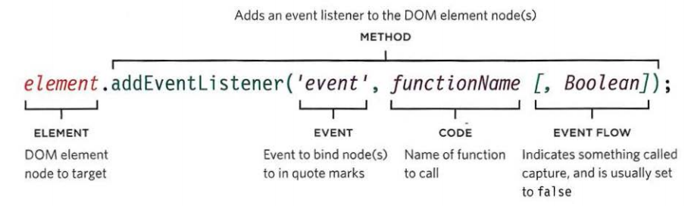
Event Handlers Event Listeners
Event listeners are a more recent approach to handling events
They can deal with more than one function at a time but they are not supported in older browsers
Here is the syntax to bind an event to an element using an event listener, and to indicate which function should execute when that event fires

Slide 23
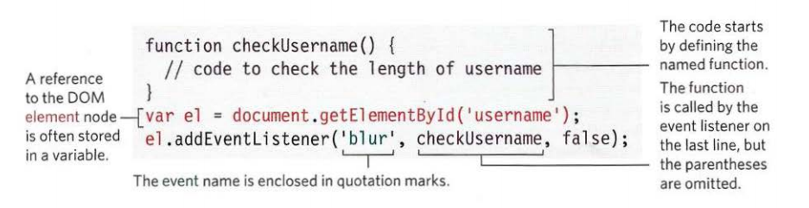
Event Handlers Event Listeners

Slide 24
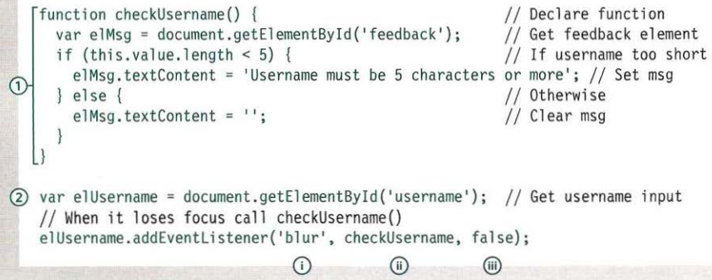
Event Handlers Event Listeners

Slide 25
Event Handlers Event Listeners
In the previous example, the event listener appears on the last line of the JavaScript. Before you write an event listener, two things are put in place:
The function to be fired should be defined first.
The DOM element node is stored in a variable. E.g. The text field is stored in a variable called elUsername.

Slide 26
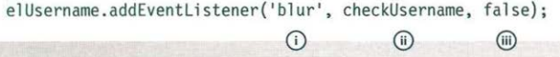
Event Handlers Event Listeners
The addEventListener () method takes three properties:
The event you want it to listen for. In this case, the blur event.
The code that you want it to run when the event fires. In this example, it is the checkUsername () function. Note that the parentheses are omitted where the function is called because they would indicate that the function should run as the page loads (rather than when the event fires).
A Boolean indicating how events flow. (This is usually set to false.)

Slide 27
Event Handlers Event Listeners
Unlike the HTML and traditional DOM event handlers, when you specify the name of the event that you want to react to, the event name is not preceded by the word "on“
If you need to remove an event listener, there is a function called removeEventListener() which removes the event listener from the specified element (it has the same parameters)
As with DOM event handlers, Internet Explorer 8 and earlier versions of IE do not support the addEventListener() method

Slide 28
Event Handlers Using Parameters with Event Listeners
Because you cannot have brackets after the function names in event handlers or listeners, passing arguments requires a workaround
When a function needs input to do its job, you pass arguments within brackets
When the interpreter sees the brackets after a function call, it runs the code straight away
In an event handler, you want it to wait until the event triggers it
Therefore, if you need to pass arguments to a function that is called by an event handler or listener, you wrap the function call in an anonymous function

Slide 29
Event Handlers Anonymous Function
Anonymous functions are functions that are dynamically declared at runtime
They’re called anonymous functions because they aren’t given a name in the same way as normal functions
Anonymous functions are declared using the function operator instead of the function declaration
You can use the function operator to create a new function wherever it’s valid to put an expression

Slide 30
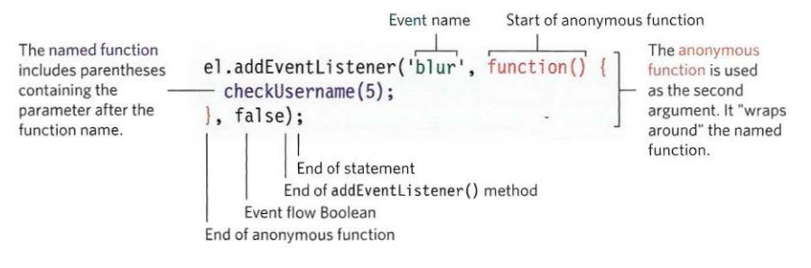
Event Handlers Anonymous Function

Slide 31
Event Handlers Anonymous Function
The named function that requires the arguments lives inside the anonymous function.
Although the anonymous function has parentheses, it only runs when the event is triggered
The named function can use arguments as it only runs if the anonymous function is called

Slide 32
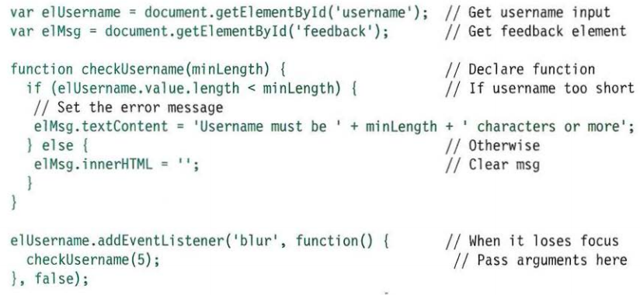

Slide 33
Event Handlers Supporting older IE versions
IES-8 had a different event model and did not support addEventL i stener() but you can provide fallback code to make event listeners work with older versions of IE
IE5-IE8 did not support the addEventListener() method
Instead, it used its own method called attachEvent () which did the same job, but was only available in Internet Explorer
If you want to use event listeners and need to support Internet Explorer 8 or earlier, you can use a conditional statement

Slide 34
Event Handlers Supporting older IE versions
Using an if ••• else statement, you can check if the browser supports the addEventListener() method
The condition in the if statement will return true if the browser supports the addEventListener() method, and you can use it
If the browser does not support that method, it returns false, and the code will try to use the attachEvent () method

Slide 35
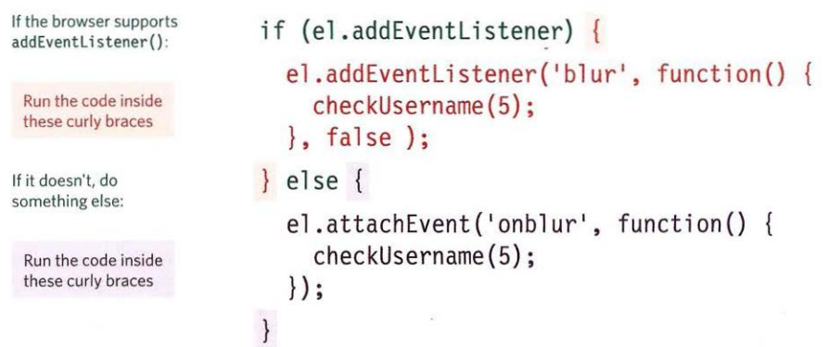
Event Handlers Supporting older IE versions

Slide 36
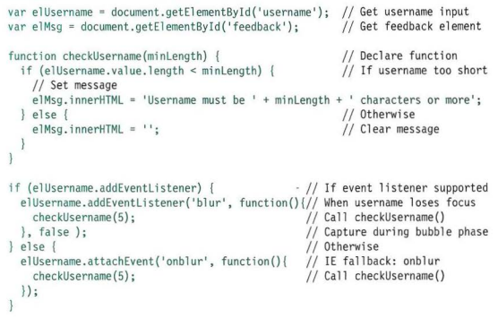

Slide 37
The Event Object
When an event occurs, the event object tells you information about the event, and the element it happened upon
Every time an event fires, the event object contains helpful data about the event, such as:
Which element the event happened on
Which key was pressed for a keypress event
What part of the viewport the user clicked for a click event

Slide 38
The Event Object
The event object is passed to any function that is the event handler or listener
If you need to pass arguments to a named function, the event object will first be passed to the anonymous wrapper function (this happens automatically); then you must specify it as a parameter of the named function

Slide 39
The Event Object
When the event object is passed into a function, it is often given the parameter name e (for event)
It is a widely used shorthand (convention)
Note, however, that some programmers also use the parameter name e to refer to the error object; so e may mean event or error in some scripts

Slide 40
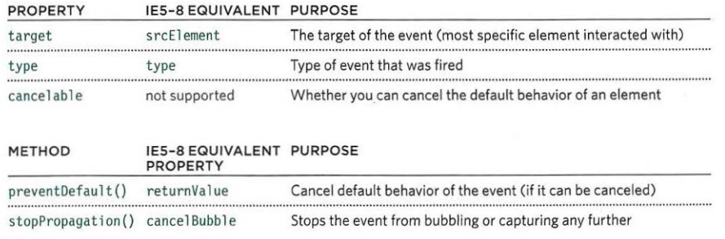
The Event Object Properties and Methods
Not only did IE8 have a different syntax for event listeners, the event object in IE5-8 also had different names for the properties and methods:

Slide 41
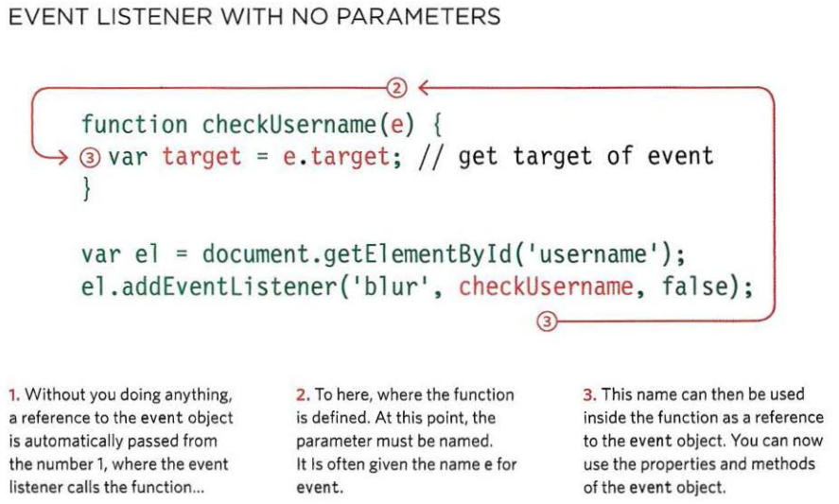

Slide 42

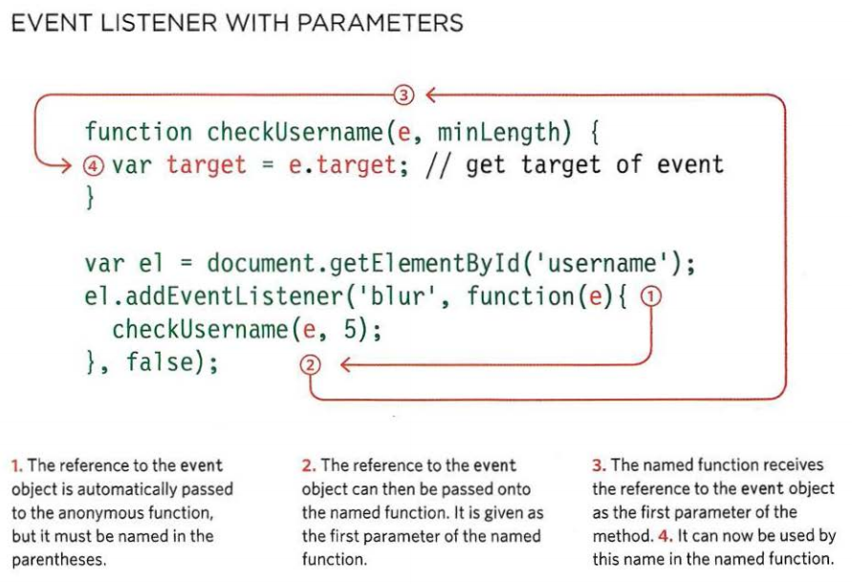

Slide 43
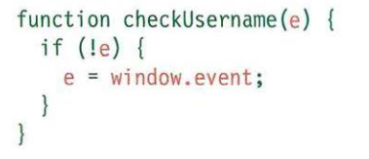
The Event Object in IE5-8
The event object is not passed automatically to event handler/listener functions; but it is available as a child of the window object
An if statement checks if the event object has been passed into the function
As previously mentioned, the existence of an object is treated as a truth value, so the condition here is saying "if the event object does not exist..."
In IE8 and less, e will not hold an object, so the following code block runs and e is set to be the event object that is a child of the window object

Slide 44
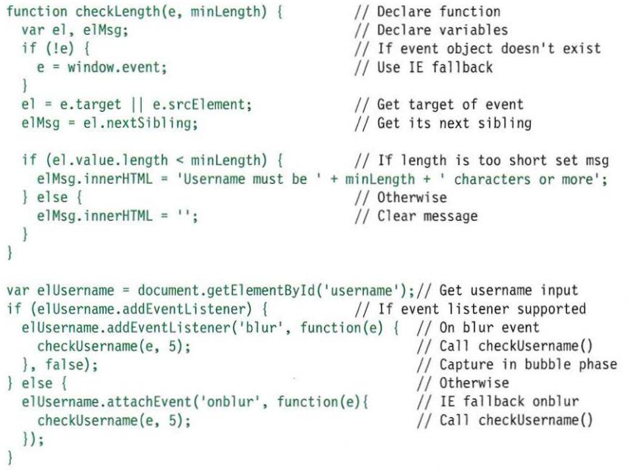

Slide 45
Practice
Access Moodle and work out Worksheet 13

Slide 46
References
Johnson, G. (2013). Programming in HTML5 with Javascript and CSS3. United States of America: Microsoft Press.
McPeak, J. (2015). Beginning JavaScript, 5th Edition (5 ed.). Wrox.
Haverbeke, M. (2011). Eloquent JavaScript: A Modern Introduction to Programming. (S. Yang, Ed.) San Francisco: William Pollock.
McFarland, D. S. (2014). JavaScript & jQuery (3 ed.). United States of America: O’Reilly Media, Inc.
Duckett, J. (2014). JavaScript and JQuery Interactive Front-End Web Development (1 ed.). Wiley.

